Slide 1
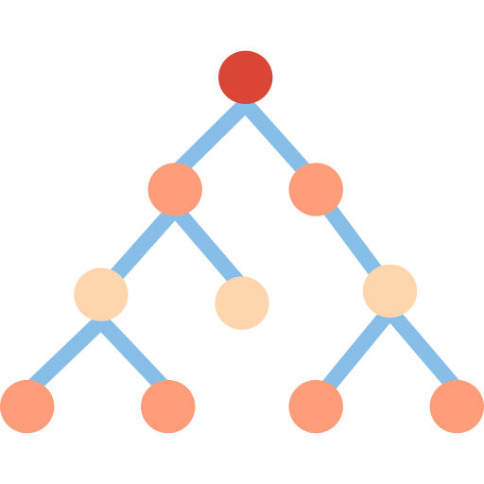
DATA2060 | CART for Regression
Group Name: Print (“Hello World”)
Group Members: Matthew Dall’Asen, Arpit Dang, Varun Satheesh, Devraj Raghuvanshi
Data Science Institute, Brown University
Date: December 10, 2024

Slide 2
Introduction | Overview
The objective of this report is to develop, implement and test a Classification and Regression Tree (CART) algorithm for regression problems. This algorithm uses a decision tree like structure to predict regression problems.
Advantages
Disadvantages
Non-linearity Handling: Models complex, non-linear relationships between features and the target variable
Overfitting: Prone to overfitting, especially when the tree grows too deep
Feature Selection: Splits only on relevant features, reducing the risk of overfitting to irrelevant variables
Instability: Small changes in the training data can result in significantly different trees because of its greedy nature during splitting
Interpretability: Easy to understand and interpret, with clear decision paths that explain predictions
Bias in Splitting Criteria: May favour features with more levels or categories when splitting
✔
X
✔
X
✔
X
Notes:
The objective behind the Classification and Regression Tree (CART) algorithm is to iteratively select features within the feature space, and splitting it into a binary decision based on specific threshold, to predict the target variable. This process is repeated for each resulting subset until a stopping criterion is met, such as the depth of the tree or number of epochs

Slide 3



Mathematical Model | Representation & Loss Function
Regression Decision Tree
Representation
Loss Function
Decision Tree: Despite being a regression problem, this is a binary decision tree. At each node, the tree partitions the input space based on a single feature (X = Rd) at a specific threshold that minimizes the loss function:
For any data point that reaches a specific leaf node, the prediction (Y = R) is the mean of the target values for all training observations in that leaf:
Loss Function: A Regression Tree uses Sum of Squared Errors (SSE) as its loss function. SSE measures the total squared difference between the actual target values and the predicted values within each node:
Where:
N is the total number of observations
Y_i is the target value of the ith sample
Y is the predicted value for the ith sample given the learned model weights
Notes:
Despite this being a regression problem, the algorithm is performed in a tree like structure with parent, child and leaf nodes.
This algorithm divides the input space, represented as a set of real numbers by d dimensions, into separate non overlapping regions. It does this by determining a split across all potential features and all potential thresholds that minimises the loss function.
As we can see on the slide, at each internal node (N), the tree partitions the input space based on a single feature, selected from d number of features. This feature may vary at each node, depending on which split minimizes the prediction error best. To create a split, the algorithm selects a threshold value for the chosen feature, effectively dividing the data into two groups based on whether value is less or greater than the threshold
This recursive partitioning of the input space continues until the data reaches a leaf node. Each leaf node, represents a specific region in the feature space and corresponds to a unique subset of the training data that falls within that region. For any data point that reaches the leaf node, the prediction y is calculated as the mean of the target values for all training observations that lie within that leaf, represented by a set of real numbers.
As mentioned previously, the loss function that is minimised at each split is the Sum of Squared Errors, which measures the difference between the actual target values and the predicted values within each node. Minimizing the SSE allows the model to identify splits that reduce the overall variance in target values within each region, leading to more accurate predictions.

Slide 4
Mathematical Model | Optimization
Primary Goal of Optimization: To split the data at each node into two subsets where we can minimize the SSE (Sum of Squared Errors).
We use a Greedy Algorithm, which selects the best split at each step to minimize the SSE.
Greedy Algorithm: It is a problem-solving approach where at each step, the logically optimal choice is made without future implications down the line.
What is the choice?
We assess all possible splits across every feature and potential split thresholds, selecting the combination of feature and threshold that yields the highest possible gain for splitting the data.
Notes:
Less on thisa

Slide 5
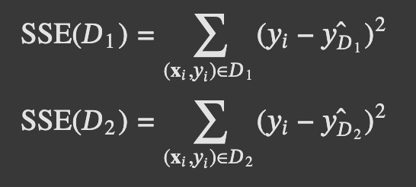

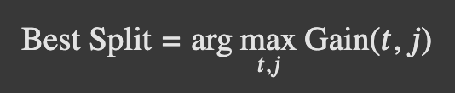
Mathematical Model | Optimization (cont’d)
What is Gain?
Gain measures the quality of the split in the decision tree’s ability to predict the target variable.
Gain is calculated as the reduction in the SSE between the parent node and its child nodes. The feature and the split threshold that result in the highest gain (highest reduction in SSE) are selected for the split to occur. Minimizing SSE reduces the overall variance in target values, resulting in a more accurate prediction.
How do we determine Gain?
j = feature t = split threshold

Slide 6
Mathematical Model | Optimization (cont’d)
Stopping Criteria
Maximum Tree Depth: A predefined maximum depth limits the growth of the tree. Once the limit has been reached, no further splits are performed. Prevents from making deep and complex trees. Also, prevents the likelihood of high variance and overfitting.
Minimum Samples per Leaf: If the number of samples within a node is below a specified threshold, the split does not happen. This prevents the likelihood of high variance and overfitting.
Homogenous Target Values: If all the target values in a node are identical, no further splits are made (SSE (D) = 0 OR Gain < specific threshold). This ensures that the tree does not split unnecessarily.

Slide 7
Implementation | Pseudocode
Class Node:
- Represents a tree node with attributes:
- `left`, `right` (child nodes)
- `depth`, `index_split_on`, `threshold`
- `isleaf` (is it a leaf?)
- `pred` (mean prediction)
- `info` (split details like gain and sample count)
Class CART:
- Initializes tree with:
- Root node using the dataset mean
- `min_samples_split` (stop splitting below this sample count)
- `max_depth` (maximum depth of the tree)
- Recursive splitting starting from root
Notes:
Less on this

Slide 8
Implementation | Pseudocode
Methods:
- `_predict_recurs(features)`:
- Traverse tree recursively, return prediction at leaf node.
- `_variance(values)`:
- Compute variance of a list of values.
- `_calc_gain(data, split_index, threshold)`:
- Calculate variance reduction from splitting the data.
- `_split_recurs(node, data, indices)`:
- Check if node is terminal (empty, uniform target values, max depth, or insufficient samples).
- If not terminal:
- Iterate over features and potential split points.
- Compute gain for each split and find the best one.
- Store split info in the node.
- Split data into left and right subsets.
- Recur on child nodes.

Slide 9
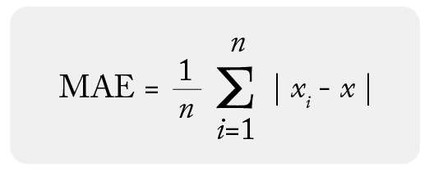
Implementation | Data & Results
Dataset: Forest Fires (UCI ML Repository)
Paper: A Data Mining Approach to Predict Forest Fires using Meteorological Data
Cortez et al. (2007)
→ 517 samples
→ 12 features
Target variable - Area burnt by forest fires
Evaluation metric: Mean Absolute Error (MAE)

Slide 10
Implementation | Data & Results
Start
→ [Data Preprocessing]
→ One-hot encode categorical features
→ Standardize all the features (StandardScaler)
→ [Loop through 30 random states]
→ [K-Fold Cross-Validation (10 folds)]
→ For each fold:
→ Split data into training and test sets
→ Train model on training data
→ Make predictions on test set
→ Calculate MAE for the fold
→ M_{rs} = [Average MAE over all 10 folds]
→ Final Score = [Average M_{rs} over all 30 random states]
End

Slide 11
Implementation | Data & Results
Start
→ [Data Preprocessing]
→ One-hot encode categorical features
→ Standardize all the features (StandardScaler)
→ [Loop through 30 random states]
→ [K-Fold Cross-Validation (10 folds)]
→ For each fold:
→ Split data into training and test sets
→ Train model on training data
→ Make predictions on test set
→ Calculate MAE for the fold
→ M_{rs} = [Average MAE over all 10 folds]
→ Final Score = [Average M_{rs} over all 30 random states]
End
Mean Absolute Error (MAE)
Paper | 13.46 ± 0.04
Our | 13.61 ± 0.38
Hyperparameters
→ max_depth: 5
→ min_sample_split: 42

Slide 12
Implementation | Data & Results
Additional Results:
Dataset | MSE (sklearn’s DTR) | MSE (Our)
California Housing | 0.5245 | 0.5245
Diabetes | 3358.6384 | 3378.0334
Hyperparameters
→ max_depth: 5
→ min_sample_split: 20
Mean Squared Error (MSE) comparison between sklearn’s Decision Tree Regressor (DTR) and Our Implementation

Slide 13
Conclusion | Final Remarks & Challenges
✅ Implemented CART regression tree from scratch
What Was Interesting?
Interpretable predictions: Provides clear, interpretable rules for prediction, making it easier to understand decision boundaries.
Greedy approach: Greedily selects the feature and threshold that maximize gain, optimizing the tree's predictive power.
Challenges Faced:
Recursion: Implementing recursive splitting in code.
Limited resources: Finding academic resources to understand the algorithm.
Creating toy datasets for the unit tests.

Slide 14
Thank You!
Questions?

Slide 15
Bibliography
[1]
[2]
[3]
Cortez, P. and Morais, A.D.J.R., 2007. A data mining approach to predict forest fires using meteorological data.
Breiman, L., 2017. Classification and regression trees. Routledge.
Scikit-learn: Tree Algorithms (CART)
Notes:
Less on this

